Slide 1
Fruit Detector
- Allison Campbell
- Chinmay Rajguru

Slide 2

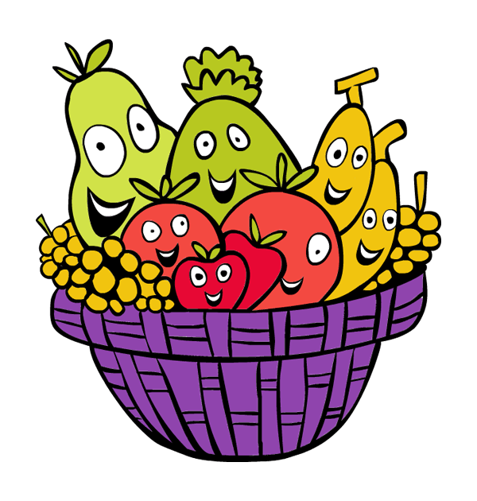
OUTLINE . . .
Problem
Solution
Demo
Technical Details & Libraries
Vision & Future Perspectives

Slide 3
Image Recognition Importance
Interpretation of pictorial information
Processing of a scene data for an autonomous machine perception
Applications
Remote sensing
Image and data storage for transmission in business applications
Medical imaging
Acoustic imaging
Forensic sciences
Industrial automation

Slide 4
Problem?
Image Recognition without Machine Learning:
High maintenance
Not scalable
Not flexible

Slide 5
Solution
Use machine learning!
Supervised Learning
Python + SciKit Learn

Slide 6
Demo

Slide 7
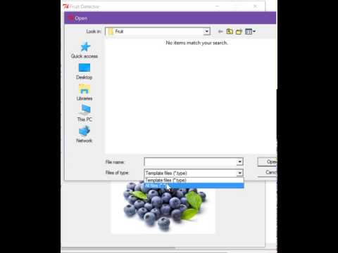
Video...

Slide 8
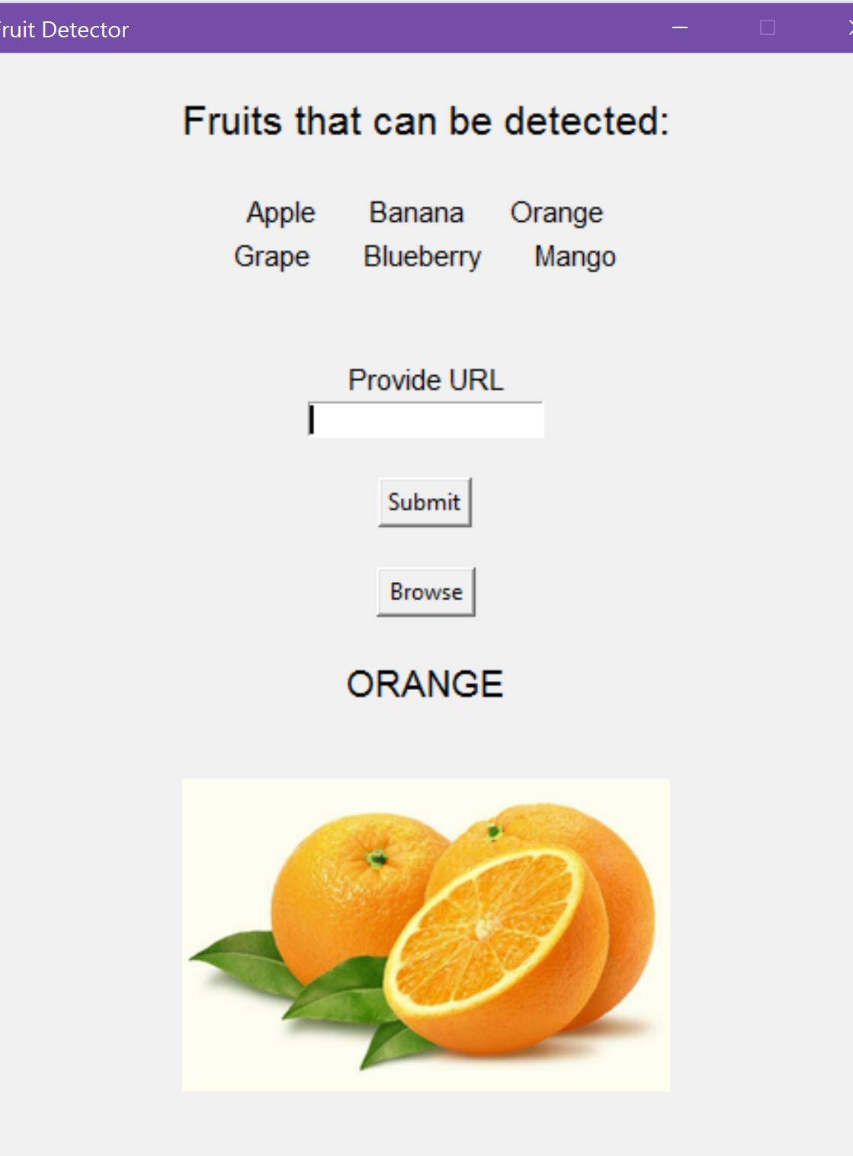
How It Works
Provide training set for each fruit type
System trains
Provide image URL or file
Get output name and image

Slide 9
Technical Details
SciKit Learn- Google developed API for Python
Fit by RGB pixel count using 80% training set for each fruit type
Test using 20% of training set
Then Predict new image given URL or file

Slide 10
Libraries
Sklearn
Svm (support vector machine)- produces a classifier
Grid_search- provide classifier and parameters
Cross_validation- hold out portion of training set for testing (20%)
Metrics- output a report of classification
Tkinter- GUI graphics
Urllib2/urlparse- process image urls
PIL- Image IO

Slide 11
Vision & Future Perspective
To learn implementation of Machine Learning using GUI + images
Future possible modifications:
Store learning data on cloud, to make the system more mobile to use
User can train the data and add more options
Since our system is just learning through images, not only fruits but any comparative images can be used as a dataset

Slide 12
ANY
QUESTIONS?

Slide 13

THANK YOU

